Slide 1
REAL ESTATE MANAGEMENT SYSTEM
-Team Pigeons

Slide 2
About the Client
Sri Lalithambigai Apartments
A privately owned Apartment complex
Based in Southern Tamil Nadu
Looking to actively expand

Slide 3
Client Requirement
A Software to digitally manage standard operations of Real Estate management.
Handling Housing Expansions
Record keeping of Tenant data.
Storage of everyday transactional data.
An advertising page for the apartment to lure future tenants.
Data storage must strictly adhere to the the rules of the apartments.

Slide 4
Client Requirement
Provisionality to have multiple employees update changes to the system.
All employees to be given their own login credentials to access the system.
The software should be scalable and should perform irrespective of the scale of attributes involved.

Slide 5
Software Proposed
Website through which Tenant,transactional and maintenance data about apartments can be managed.
The data will be stored in an organized and efficient manner.
The website will also act as an advertising platform to highlight the features, facilities and services offered by the Apartment.

Slide 6
Software Proposed
The rules and regulations of the apartment can also be highlighted in the website
There will be a secure login capability which only employees with proper credentials can access.
The UI will be simple to use.

Slide 7
Team Structure
Product Owner - V.Meganathan
Scrum Master - Nandini R
Development Team
Nandini R
Navaneetha Krishnan S
Alagappan
V.Meganathan

Slide 8
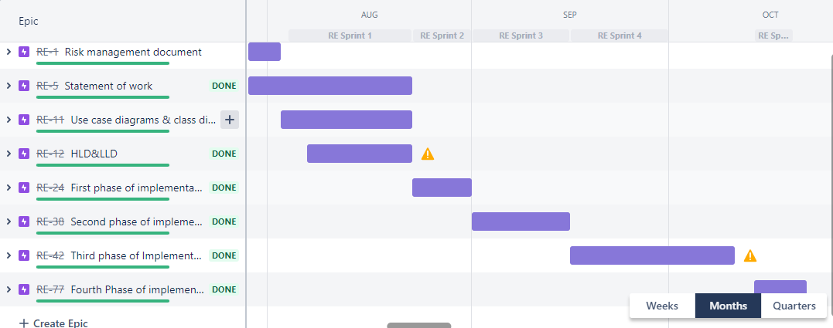
ROAD MAP

Slide 9
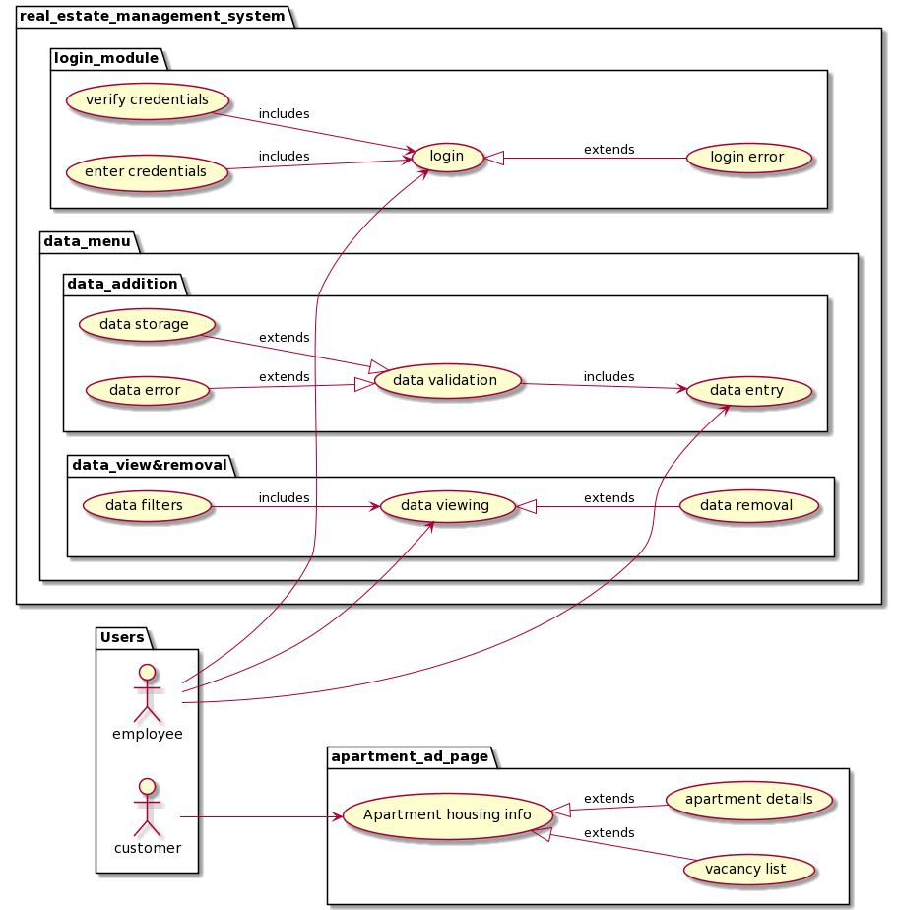
Use case diagram
Housing-info
Login Module
Data Addition
Data Storage
Data Viewing
Data Removal

Slide 10
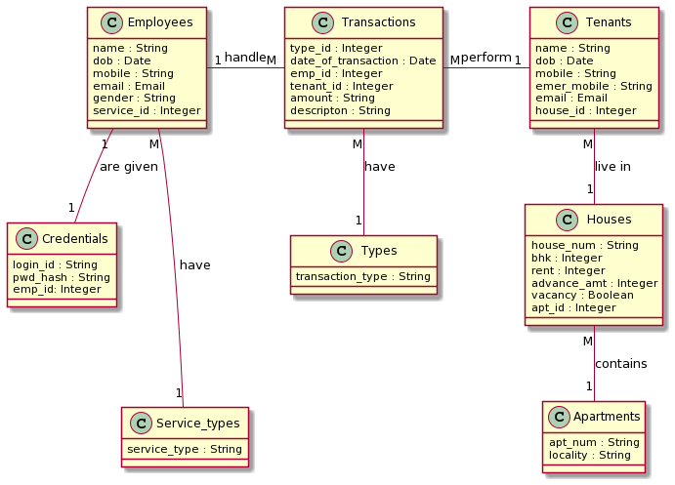
HLD(Class diagram)

Slide 11
Software requirements
Front end:
HTML5
CSS
JavaScript
Back-end:
Flask 2.0.1
Jinja TL
SQLAlchemy
Alembic for Flask

Slide 12
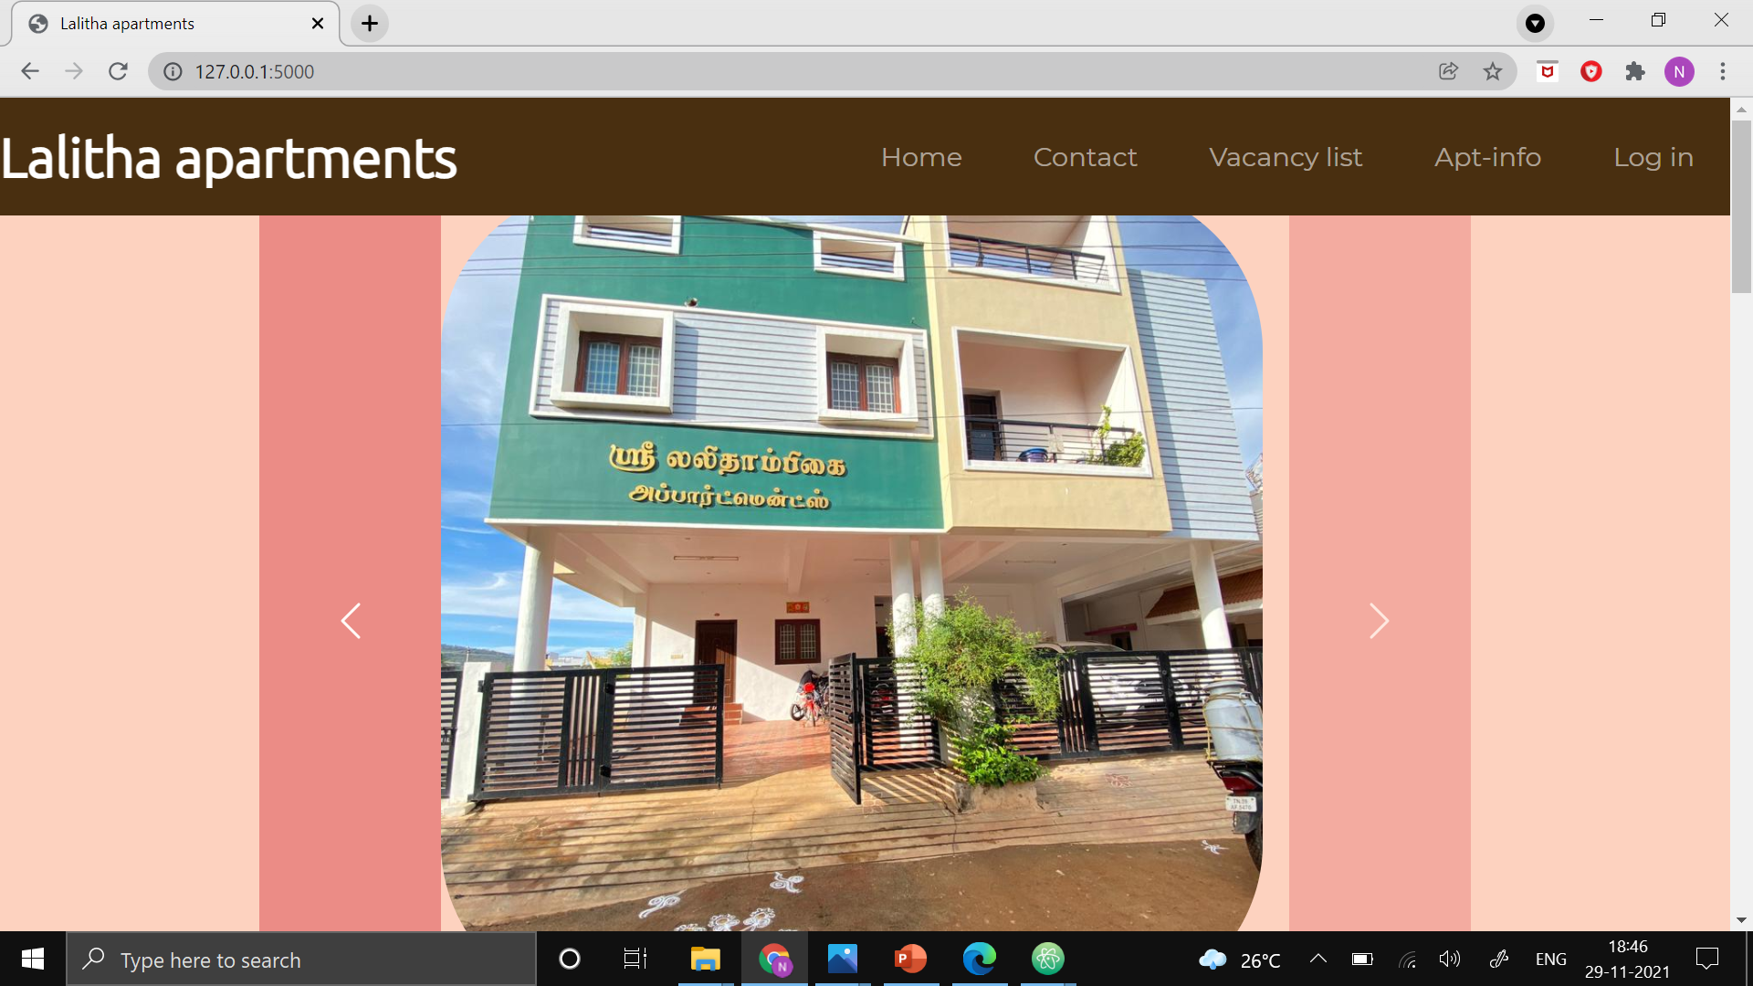
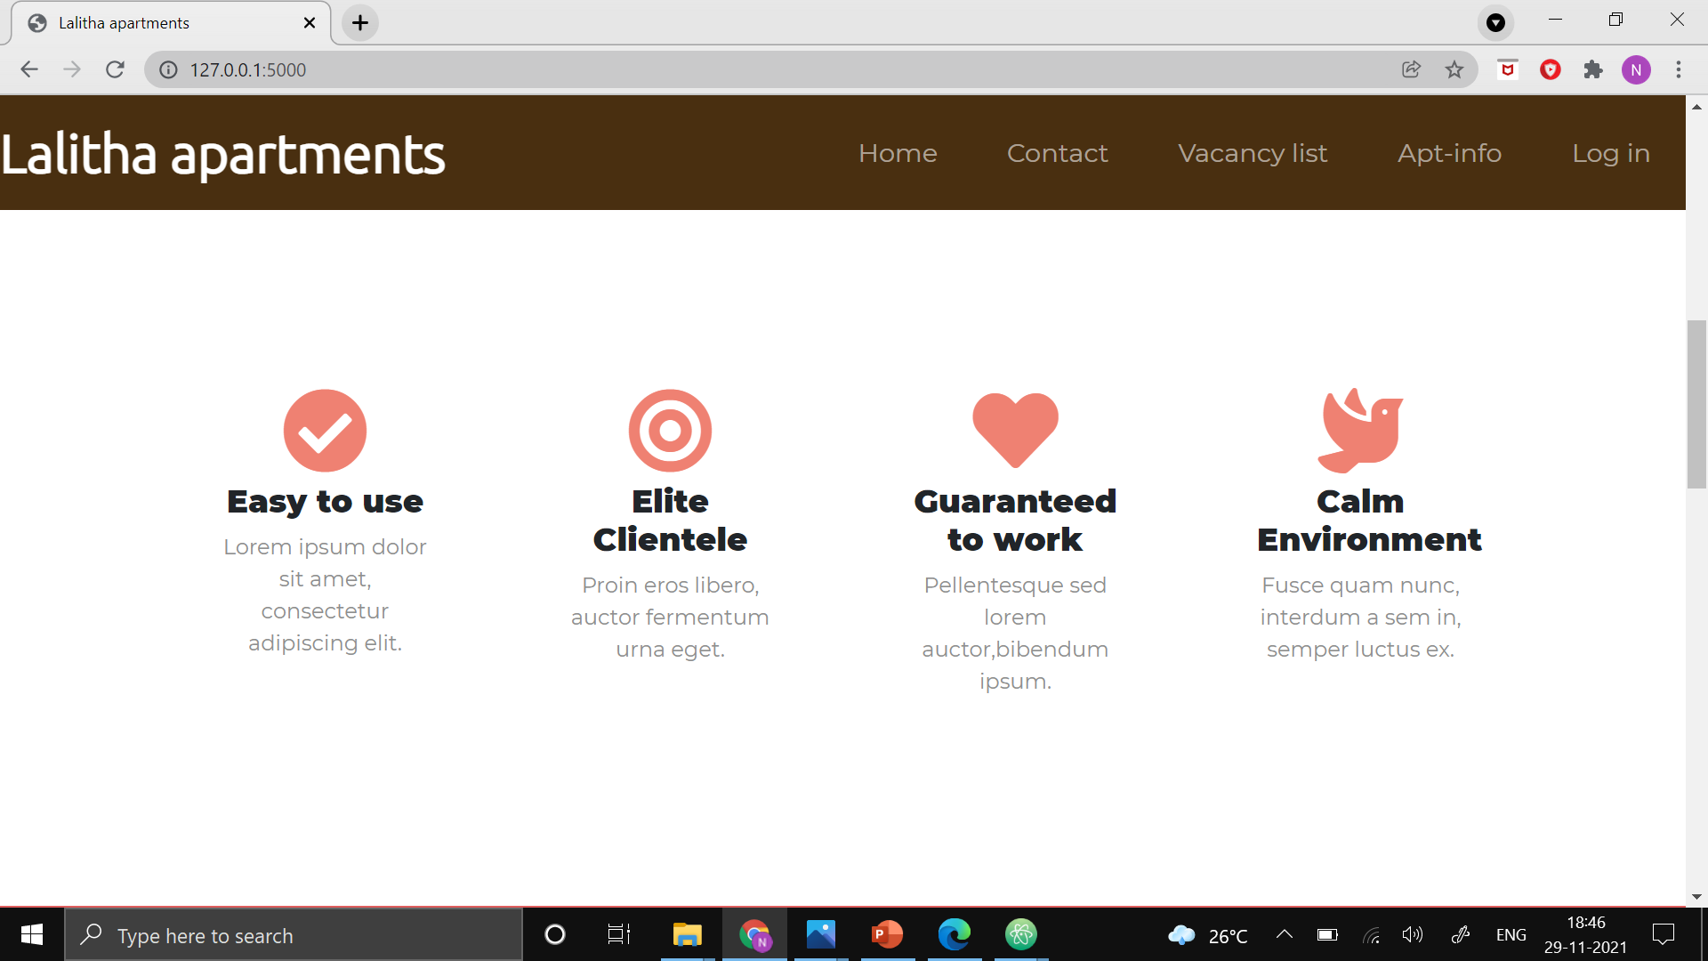
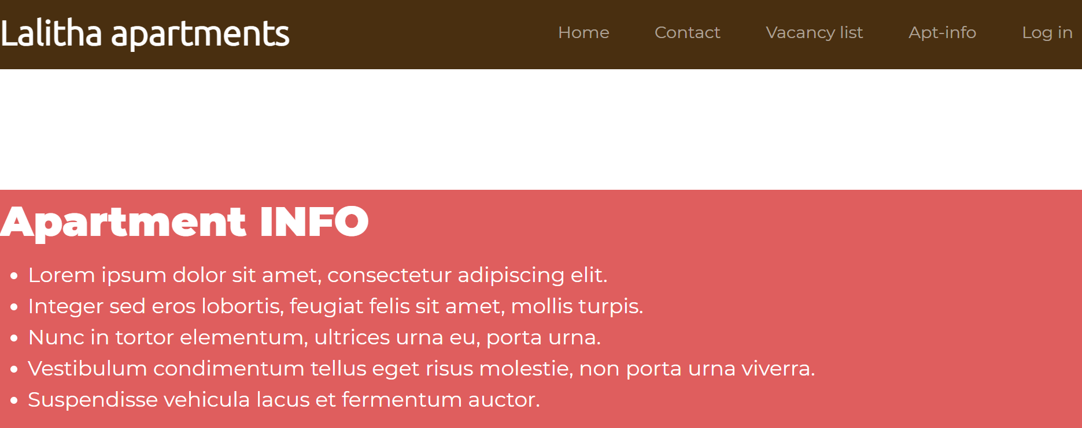
Advertisement Page
Notes:
Advertisement page has details about the features and information regarding the apartments, This page is developed using html,css stylings and bootstrap. This page has navbar which is used to navigate to all other pages in this web application.

Slide 13
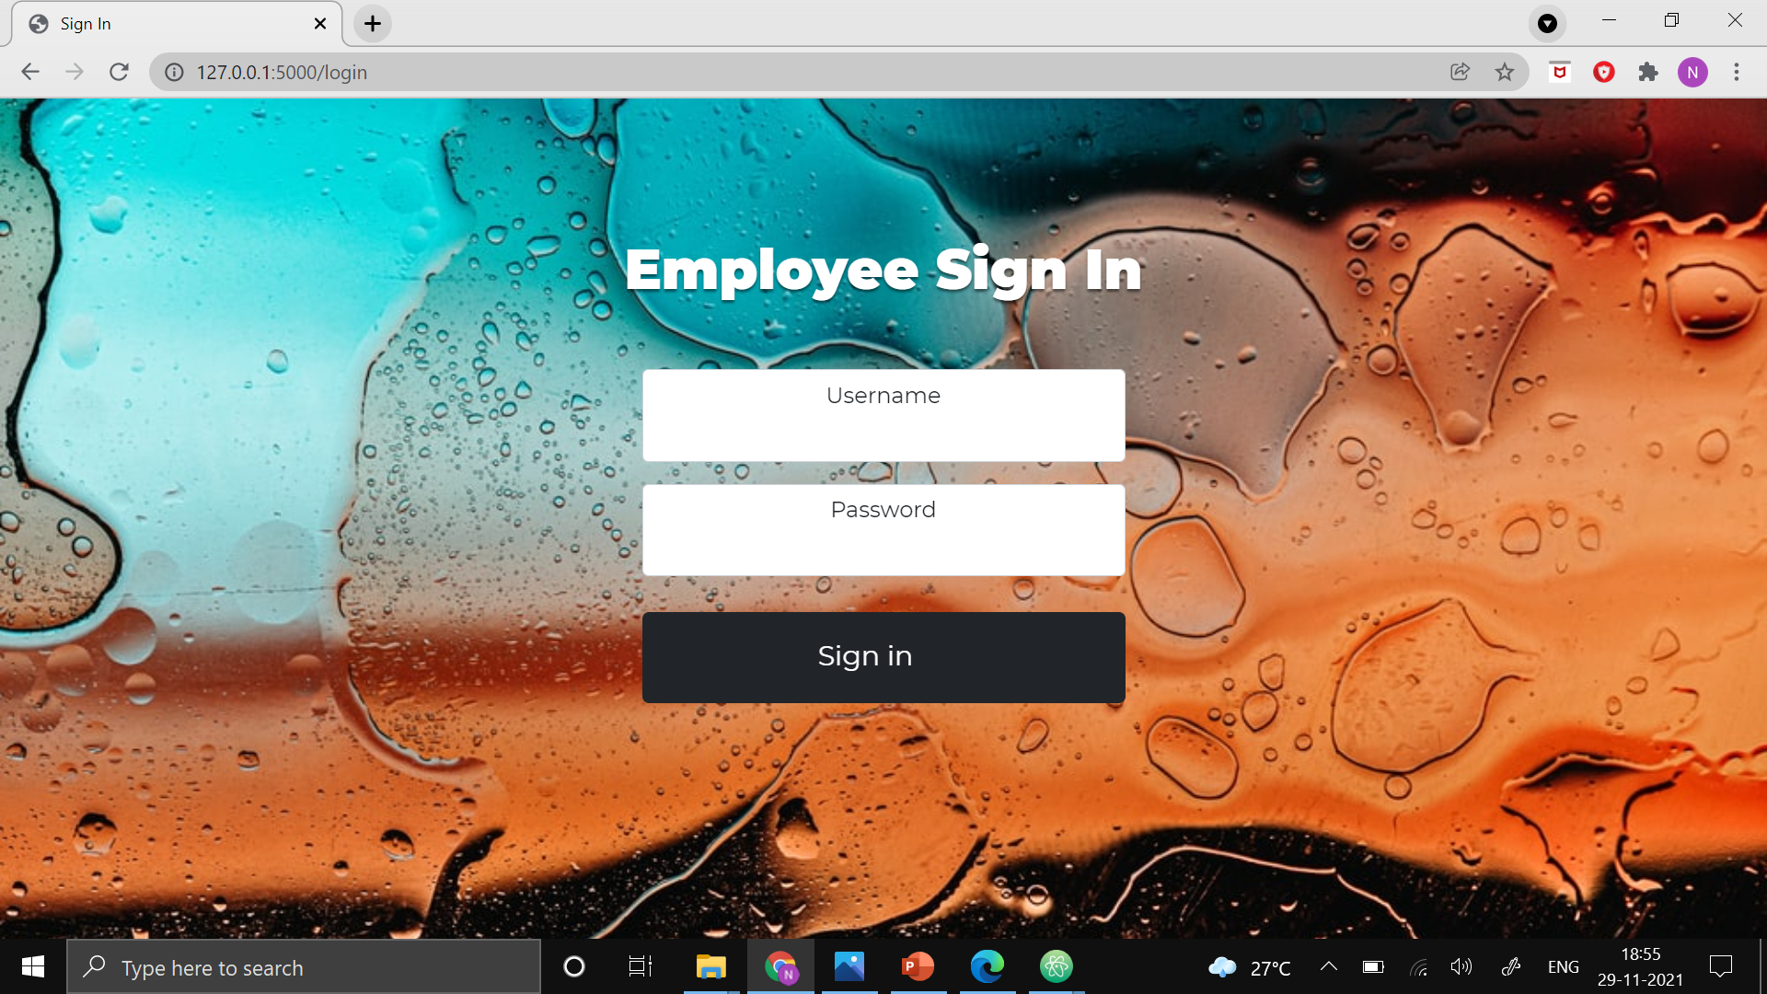
Login Module
Password is stored in a secured way using Hashing technique.
Login credentials will be provided only to a particular class of employees.
Once Logged in into the webapp it will remain logged in unless logged out manually.

Slide 14
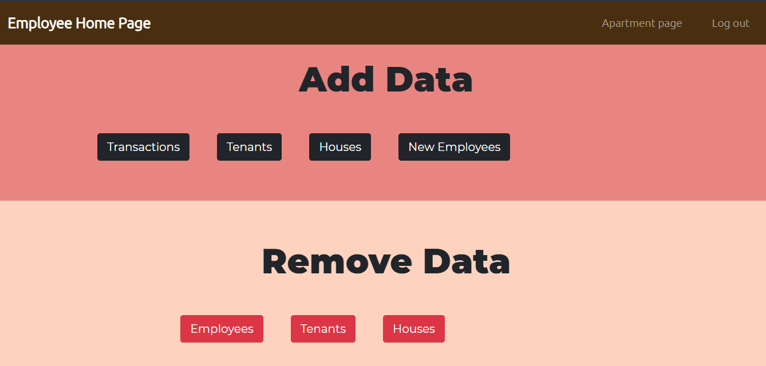
Data Menu
The data menu is home base for the REMS. All required pages can be navigated to from here.
The page is split into 2 sections, for data addition and storage, and for data inspection and deletion.

Slide 15
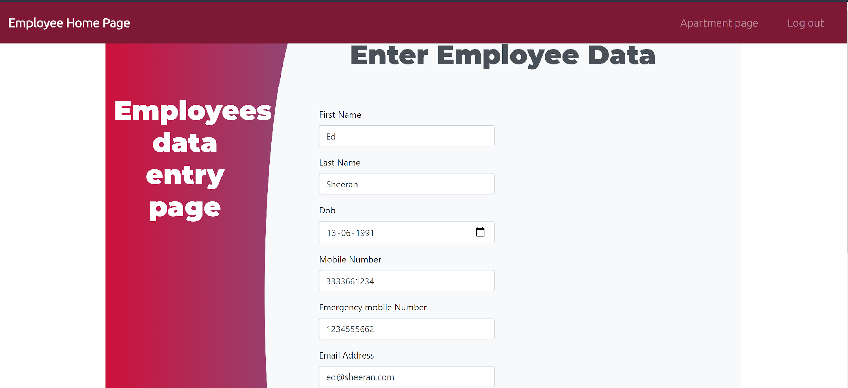
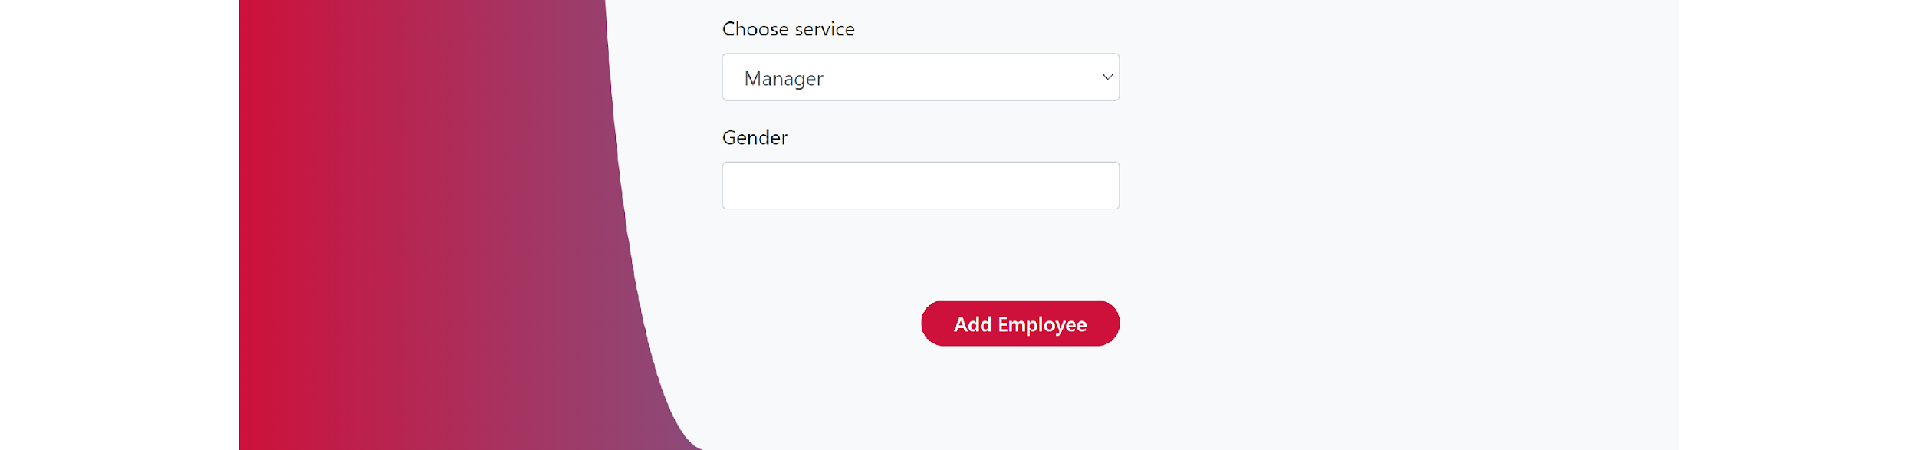
Data Addition and Storage
Data addition Pages, let the user enter information through forms.
Upon clicking the submit button, the entered data is validated against the decided constraints and data is stored
If not valid, the user is notified by the use of error pop-ups.

Slide 16
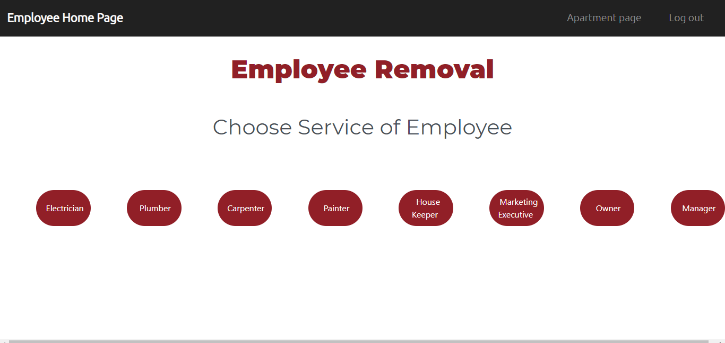
Data Search Filter
Data filter mechanisms have been implemented, so it is possible to consume the data in an organised and meaningful manner.
It also helps to save time in searching for relevant data.

Slide 17
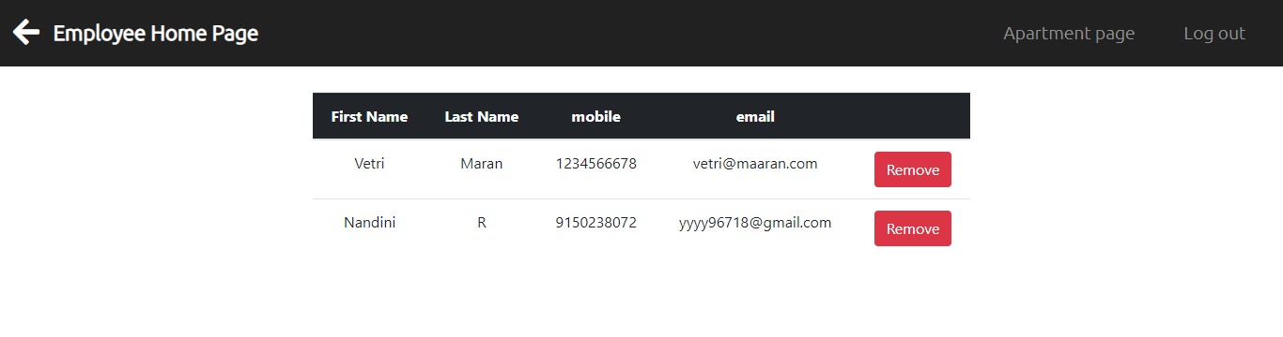
Data Viewing and Deletion
Stored data can be viewed and inspected upon in an organized and meaningful manner.
Outdated or out of cycle data can be deleted according to the users will.

Slide 18
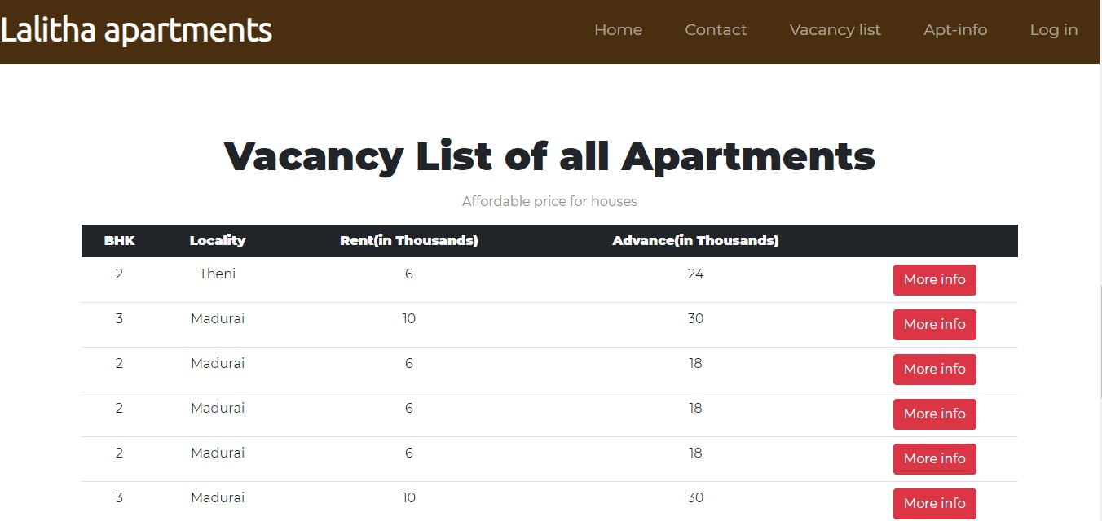
Vacancy List
Displays the list of vacant homes available in different apartments,along with their details
More info button displays the information specific to the particular apartment that home is located in.

Slide 19
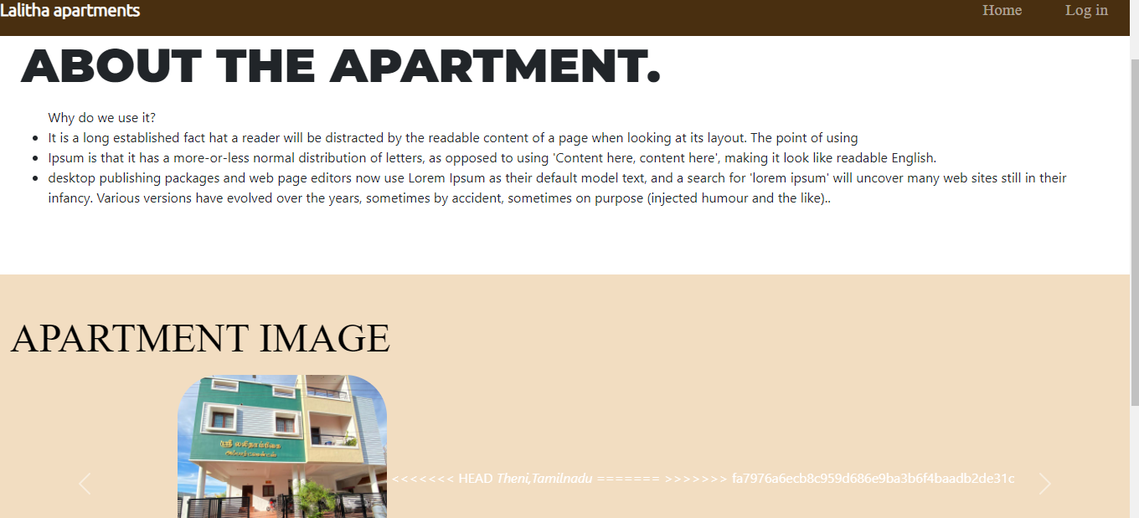
Apartment information
Upon clicking on more info buttons in the advertisement page, users can see information specific to a apartment building.
This is another advertising feature, which was requested from the client side.

Slide 20
Future Improvements
Deletion of related data, ie when a House is deleted, the tenant record of that house can also be erased.
Search Filter options can be applied to transaction viewing.
Feature to add apartments.

Slide 21
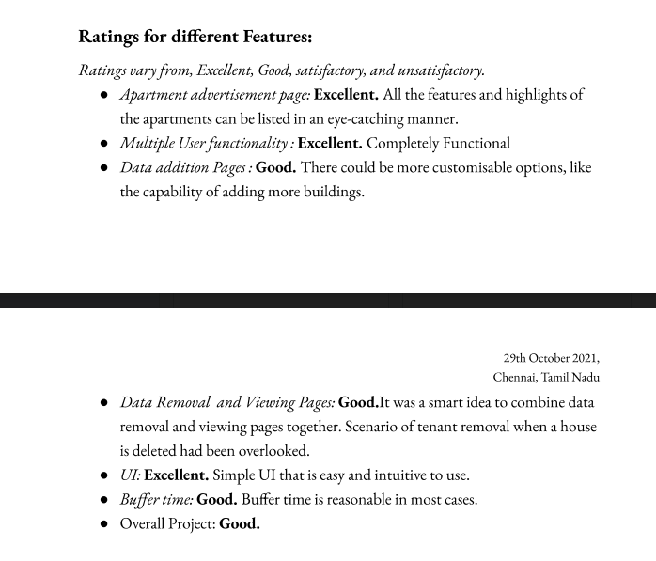
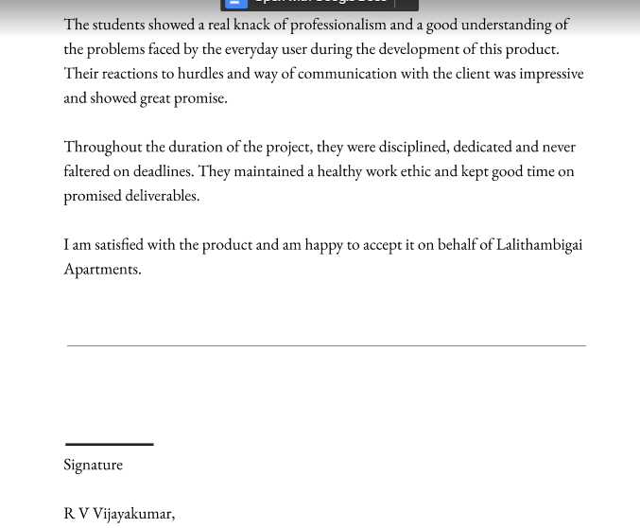
Client Feedback

Slide 22
Thank You

